Slide 1
Writing Research Proposals
Mark Unwin

Slide 2

Research Proposals
Proposal = basis upon which supervisor and research degrees committee can begin to judge value or potential of your research work
Many universities demand a great deal of work prior to submission of a research proposal
Drawing up research proposal is first main task you will be involved in with your supervisor
Before you formally submit your research proposal, you will need to:
carry out a substantial amount of early research work, some literature review and searching
identify the theoretical and methodological underpinnings to your work

Slide 3
SOURCES FOR IDEAS
?
YOUR personal interest.
Tutor comments, encouragement and advice.
Taught modules ~ content issues and personal curiosity.
Current research interests and publications of your tutors.
General advice/guidance for topic choice in the programme Handbook.
Current issues of attention and discussion in YOUR professional journals.
Work-related/based issues that may require explanation or examination.
Related concerns that are voiced in YOUR professional community.
Issues raised by visiting speakers.
Source: Hart, 2005: 68

Slide 4
QUESTIONS ABOUT RESEARCH ON THE TOPIC
Has anyone else investigated the topic?
When and how?
What were their research questions?
How reliable / valid was their investigation?
What methods were used to collect the data?
What did they find/prove/develop?
Lots of
references
Theoretically
focused
Practically
focussed
Few
references

Slide 5
What ‘space’ will your dissertation occupy?
Application of conventional research instruments in a ‘new’ field of investigation.
Combining disparate concepts in new ways to investigate ‘something’.
Seeking a new understanding of ‘something’.
Extending the work of someone else.
Explaining a familiar issue from a different perspective.
Repeating the investigation of others but in a different setting/context.
Demonstrating the significance of old/new methodologies in current settings.
Source: Trafford and Leshem, 2008: 16-17

Slide 6
SOURCES OF RESEARCH QUESTIONS
The
general
literature
A ‘problem’
for which answers are
considered necessary
Theoretical
perspectives in one
or more disciplines
Links to
YOUR research
Curiosity about something
or
an area of interest
Propositions emerging
from other research
Answers to earlier
research questions that
prompt further questions
Translation of research
‘aims’ into research
questions to be answered
‘Thinking’

Slide 7
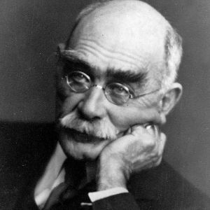
KIPLING AS THE RESEARCHER’S FRIEND
I keep six honest serving men
They taught me all I knew;
Their names are What and Why and When
And How and Where and Who.
Rudyard Kipling (1865 – 1936)
These six words provide a practical template from which to interrogate a
prospective research topic to clarify what and how it might be investigated.
The same questions offer another template to determine how the research
should be designed and the fieldwork undertaken.
Using the six questions to audit the research process can also check that the
research process is internally cohesive and methodologically coherent.

Slide 8
APPLYING KIPLING’s QUESTIONS TO YOUR RESEARCH DESIGN
WHAT is it that you want to discover / prove / disprove?
WHY do you want to undertake this research and why is it important?
WHEN is the investigation to be conducted and over what period?
HOW do you intend to investigate the topic and what choices need to be considered?
WHERE is the topic located, where will it be investigated, what issues should be considered?
WHO are the respondents, why them and how accessible are they?
Answering these questions determines the primary boundary for your research.
Source: Trafford and Leshem, 2008: 90-93

Slide 9
PRACTICAL CONSIDERATIONS
THE CONSIDERATIONS PRODUCT STAGES
Questions
Methods
Benefits
for you
DRAFT
PROPOSAL
PLAN
Publications
Research
Trends
LIBRARY
SEARCHES
FEASIBILITY
KIPLING ???
Brainstorm
Explore
links
IDEA
DEVELOPMENT
CONCEPTS
Interest
YOUR prior
knowledge
Reading
INITIAL VIEWS
OPTIONS
From: White, 2000: 9-19

Slide 10
Consider
What is the 'gap in knowledge' that your work will address?
What specifically are you looking for? What are the main questions you want to ask? What about subsidiary questions? Do you want to challenge any assumptions or conclusions of previous research?
What are you seeking to prove?
What factors will you consider the relationship between?
What difference will your research make? Why does it ‘matter’?
Are there any factors that may have a negative impact on your ability to achieve your research objectives?

Slide 11
A Possible Outline
A Working Title of the Topic Area
General Overview of Area
Identification of the Relevant Literature
Key Research Questions
Methodology
Timescale/Research Planning
Bibliography
(EG7020 and EG7030)

Slide 12
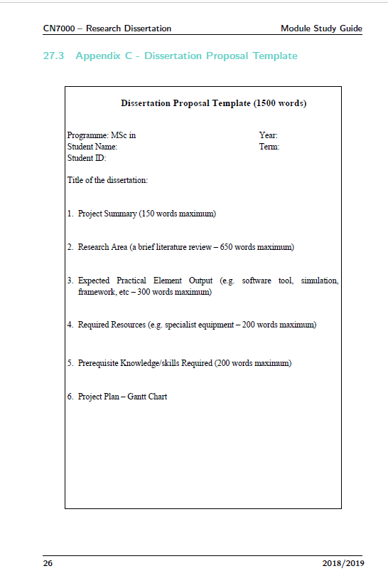

Slide 13
A Working Title of Topic Area
Should be:
Succinct, descriptive, do more than convey just key words associated with proposed research
Often titles are stated in terms of a functional relationship, because such titles clearly indicate independent and dependent variables
Eg Changing factors for team support in English football:
How geographic determinants play a role in determining match attendance
In some disciplines (eg the Humanities) it is common have an informative but catchy title, with a longer more descriptive subtitle:
Eg ‘You Looks Like Youse Yo’ Own Daughter’:
Figuring (in)fertility and maternity in Their Eyes Were Watching God
So
short, sharp, and describe what your research is about
it may also be a ‘working title’ that you will revise as your project develops

Slide 14
Research Questions should be
CLEAR
They are unambiguous and easily understood.
SPECIFIC
They are sufficiently specific for it to be clear what constitutes an answer.
ANSWERABLE
It is possible to see what data are needed to answer the question ~ and how
those data will be collected.
INTERCONNECTED
The questions relate in meaningful ways, forming a checkable and coherent whole.
SUBSTANTIALLY RELEVANT
They are worthwhile ~ non-trivial questions worthy of the research effort that
will be expended.
Source: Punch, 1998:49

Slide 15
A Working Title of the Topic Area
Title should serve as a mini-abstract of your investigation
So put the most important words first.
Eg
"Left-handedness in students and its relationship to learning preferences“
implies that the focus will be on "left-handness."
But
"Learning preferences in students and the connection to left-handedness"
implies that the focus will be on "learning preferences."

Slide 16

A Working Title of the Topic Area
Craft your title. Make every word the right word and every word count:
A linguistic analysis of slang used in Eminem album song lyrics
A study of the role of cultural materials in contemporary graphic design
The Relationship Between Self-Efficacy and Help Evasion
‘Do you want extra veg with that?’: Two observational studies examining the effect of a social norm and a health message on the purchase of vegetables in student canteen settings
Assessing the determinants of internet banking adoption intentions: A
social cognitive theory perspective
The effects of oestrogen, alcohol, and age on the
astrocytes in female rats following an
inflammatory stimulus

Slide 17
Appropriacy and Accuracy: Making Assumptions
How gifted children aren’t having their needs met in schools.
An investigation into the problems of children whose mothers work full-time.
These questions make assumptions, the outcomes of which have already been decided
Therefore need to be reframed more objectively
eg
‘A review of evidence for the claim that highly able children would benefit from more targeted attention in primary schools’
Or
‘A survey of the effects of working parents on young children’

Slide 18
Appropriacy and Accuracy: Precision
A review of support for children with dyslexia in schools in the UK.
Learning in museums: how well is it done?
An investigation of how twins communicate in general.
Comment:
These questions are too broadly conceived
Eg:
1. is too ambitious (All schools in the UK? All age phases? How is this measured?)
2 and 3 are too vague to be put into practice:
Number 5: What kind of learning in what kind of museums? Who is doing the learning? Children? Adults? Tourists? What is meant by ‘how well’?
Number 8: Communicate with whom? Each other? Their families? What age are these twins? and so on)
Both questions lack clear definitions and parameters.

Slide 19
Appropriacy and Accuracy
Preschool children on gallery visits: which workshop pedagogies best help them engage with artworks at Tate Britain?
Commentary:
Now better:
Nicely limited and clear
Cites specific instances to be reviewed
claims it makes from results can be easily related to similar scenarios
Doesn’t need to be grandiose and doesn’t claim influence beyond particular situations
HOWEVER,
If dissertation provides thoroughly researched context and rationale, their conclusions can provide a useful support or refutation of current practice ie have wider implications

Slide 20
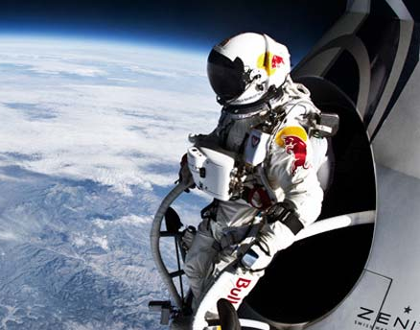
General Overview of Area
Should
take form of a brief abstract of your proposed general area of study
identify discipline(s) within which it falls
Possibly refer to way in which your background and experience gives you competences in your chosen area
It should include:
The research question
Rationale for the study
hypothesis (if any)
proposed method
Descriptions of the method may include:
the design
Procedures
The sample
Any instruments that will be used

Slide 21

Creating A Research Space
Broadly speaking you need to :
Explain what the current situation is
Identify a gap (space) in our knowledge
Explain how to intend to close that gap (ie occupy that space)

Slide 22
The Research Space or Gap
There’s a really useful handout on Creating a Research Space on Moodle- a pdf called ‘CARS’
It covers:
Establishing a territory
Establishing a niche
Occupying the niche
It also has some really useful language /expressions you can use.

Slide 23
Language for Creating A Research Space what we know, creating a space, filling the space?
Many recent studies have focused on ....
So far, investigations have been confined to ...
The previous research ... has concentrated on ....
The study of ... has become an important aspect of ....
The aim of this paper is to ...
The purpose of this investigation is to ...
The purpose of this paper is to ..
The remainder of this paper is divided into five sections ....
In this paper, we argue that ....
In this paper, we give results of
A central issue in ... is ....
Although considerable research has been devoted to ... , rather less attention has been paid to …
However, few studies/investigations/ researchers/attempts ....
However, little information/attention/ work/data/research ....
Recently, there has been growing interest in ....
The increasing interest in ... has heightened the need for ....
The research has tended to focus on ...,rather than on ....

Slide 24
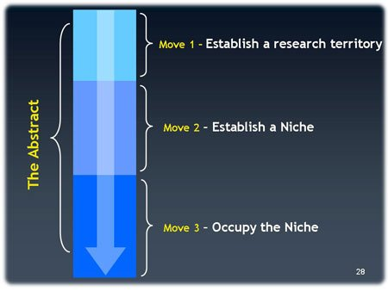
CARS method (Creating A Research Space)
For more information on structuring:
http://sana.tkk.fi/awe/style/reporting/sections/intros/cars/cars.pdf
And:
http://apresource.wordpress.com/2007/05/08/the-cars-model-creating-a-research-space/
For more guidance on Language :
http://sana.tkk.fi/awe/style/reporting/sections/intros/cars/cars1-1.html

Slide 25

Identification of the Relevant Literature
Demonstrate awareness of existing debates and issues raised in relevant bodies of literature.
Make references to key articles and texts to show that you appreciate their relevance to your research area.
Ideally you should demonstrate that your proposed area has not been studied before.
Ensure your review:
Has organisation and structure
Has focus, unity and coherence
Does not repeat information
Cites influential papers
Keeps up with recent developments
Critically evaluates cited papers
Does not citing irrelevant or trivial references
Is not too dependent on secondary sources

Slide 26
Literature Review
There’s a really useful 6 page handout on writing Literature Reviews on Moodle-a pdf called ‘How to Write a Literature Review’
It describes some approaches for organizing your response, useful language and a sample extract

Slide 27
Key Research Questions
Need to demonstrate that topic can be completed within normal time period allowed. Therefore, you need to demonstrate that it is manageable, and so focus on key questions within your niche area.
Remember Kipling!

Slide 28
Writing Aims and Objectives
There’s a short Powerpoint on ‘Writing Aims and Objectives’ on Moodle.
It clearly describes the difference between the two, and provides notes on key language and some worked examples

Slide 29

Methodology
Need to:
demonstrate an awareness of methodological tools available to you
show some understanding of which would be suitable for your research
Qualitative methods, including the analysis of interviews, maybe appropriate
Or your approach may involve forecasting or statistical modelling
In other cases you may be combining methodologies
You need to specify approach you feel will be most appropriate

Slide 30
METHODOLOGY AND METHODS
Research methods are the means by which the methodology is achieved and realised.
Methods only arise in the service of specific needs and purposes. Their usefulness falls away
if, and as, these needs are met and the purposes are fulfilled.
The appropriateness and purpose of each research method ~ how it contributes to answering
the research question(s) ~ has to be clearly explained within the research methodology.
Methods are simply instruments that collect data in the field.
Methods are discrete ways that collect specific forms of data, and may be used on their own
or in combinations to provide deeper forms of data collection.
It is the considered selection and application of research methods that provide a form of
distinctiveness to an investigation.
Methodology is the research strategy from which fieldwork is undertaken.
It is either deductive (quantitative), inductive (qualitative) or uses mixed methodologies.

Slide 31

Timescale/Research Planning
Need to demonstrate an awareness of the need for planning and the timescale of the research.

Slide 32
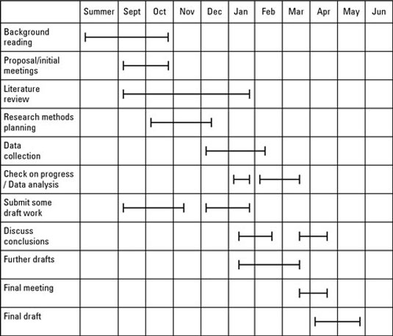
A Gantt Chart

Slide 33
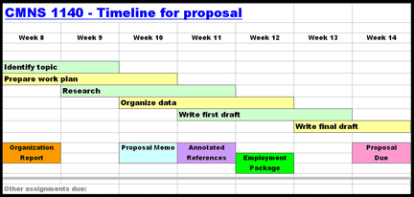

Slide 34
A Typical Dissertation Schedule
There’s a very detailed breakdown of all the stages of a typical dissertation schedule on Moodle.

Slide 35

Bibliography
include short list of references to key articles and texts included in application
You should use the Harvard Referencing System as set out on Cite Them Right (website).

Slide 36
And remember…
• Don‘t try and do too much as you only have a limited period of time
• Clarity essential
• Note marking scheme –what are your tutors looking for?
• REMEMBER
You can change proposal as you go along

Slide 37
Examples
There are a couple of good examples of dissertation proposals on Moodle

Slide 38
YOUR TOPIC
Recognise that it can/should lead to something else.
See relevance in the topic for . . . .
Be excited about the findings.
Want to learn about it.
Be curious about it.
Read about it.
Live it. Breathe it. Own it.

Slide 39

WHY
DO YOU
REALLY
WANT
TO DO THIS RESEARCH ?

